Slide 1


GeoEqua
NASA Space Apps ‘24
Gender and Climate Challenge
Mehmet Acar - Yeşim Acar

Slide 2

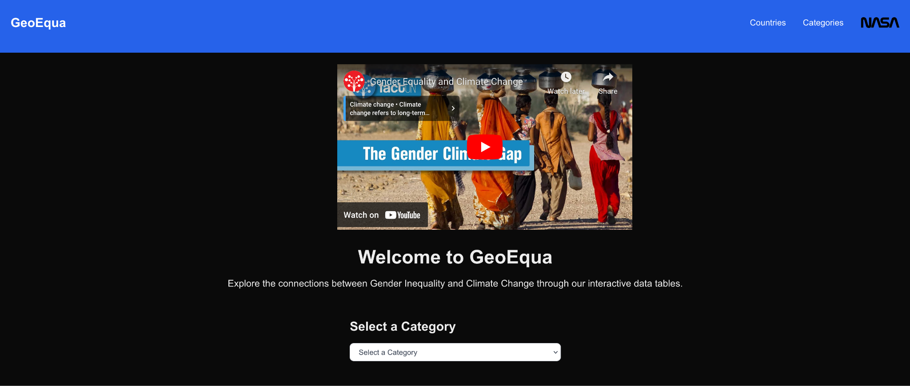


GeoEqua
GeoEqua is a web platform that analyzes the relationship between gender inequality and climate change.

Slide 3
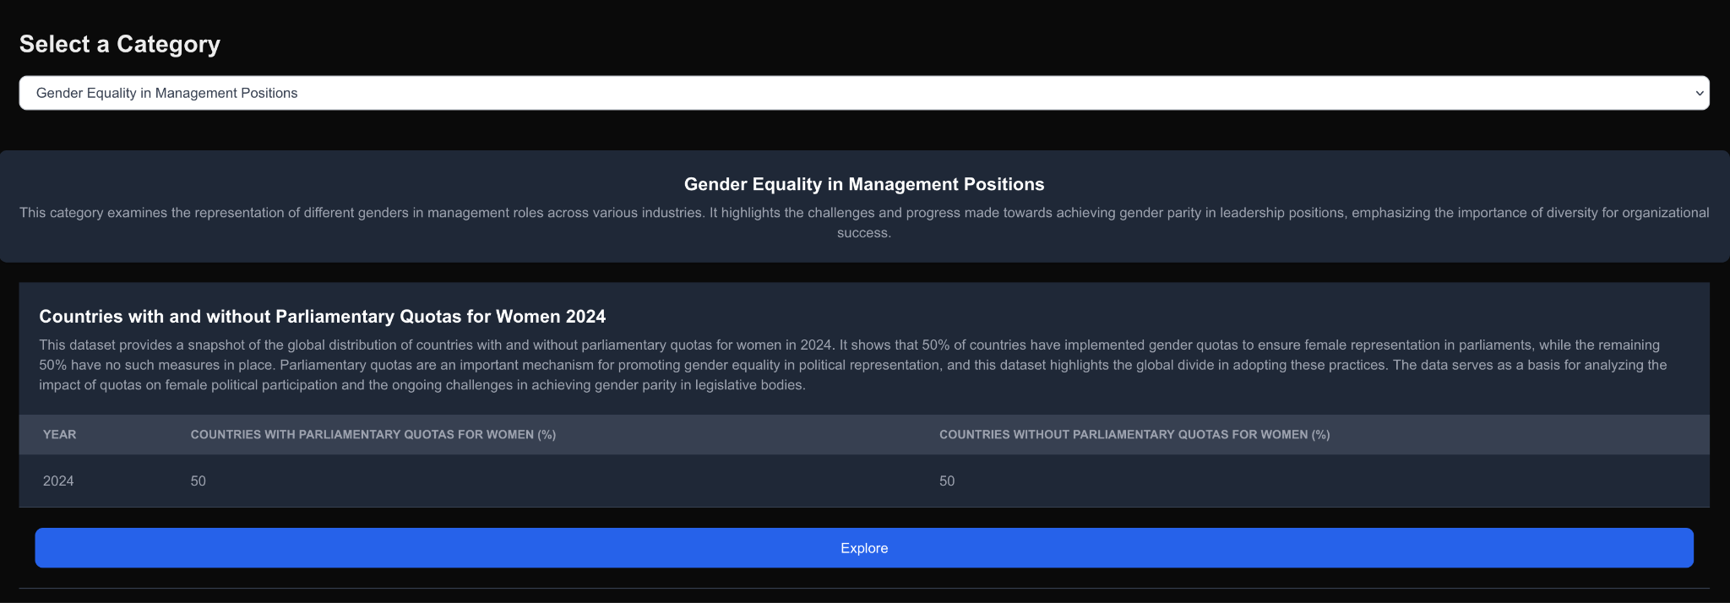

Data Visualization and Interactive Analysis
Users can view country and age-based data through graphs and tables and examine the relationships between these two global issues.

Slide 4

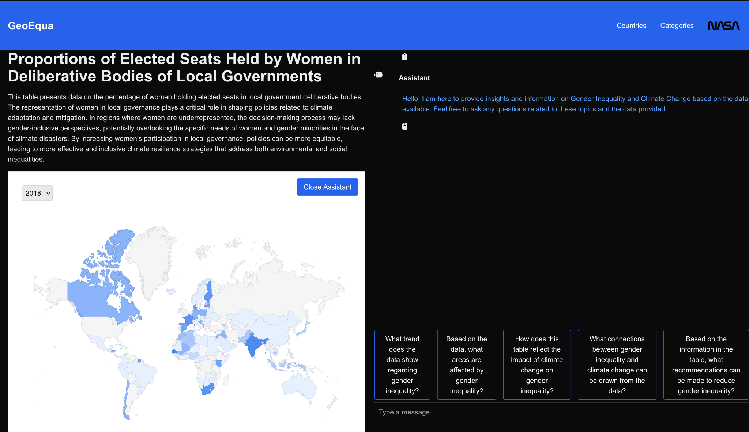
GeoAI Assistant
GeoAI interprets the data of the topic selected by the user from the web interface.
Users contacts GeoAI with questions on climate change and gender inequality.
Thanks to this communication, users obtain meaningful results from the questions they ask.

Slide 5

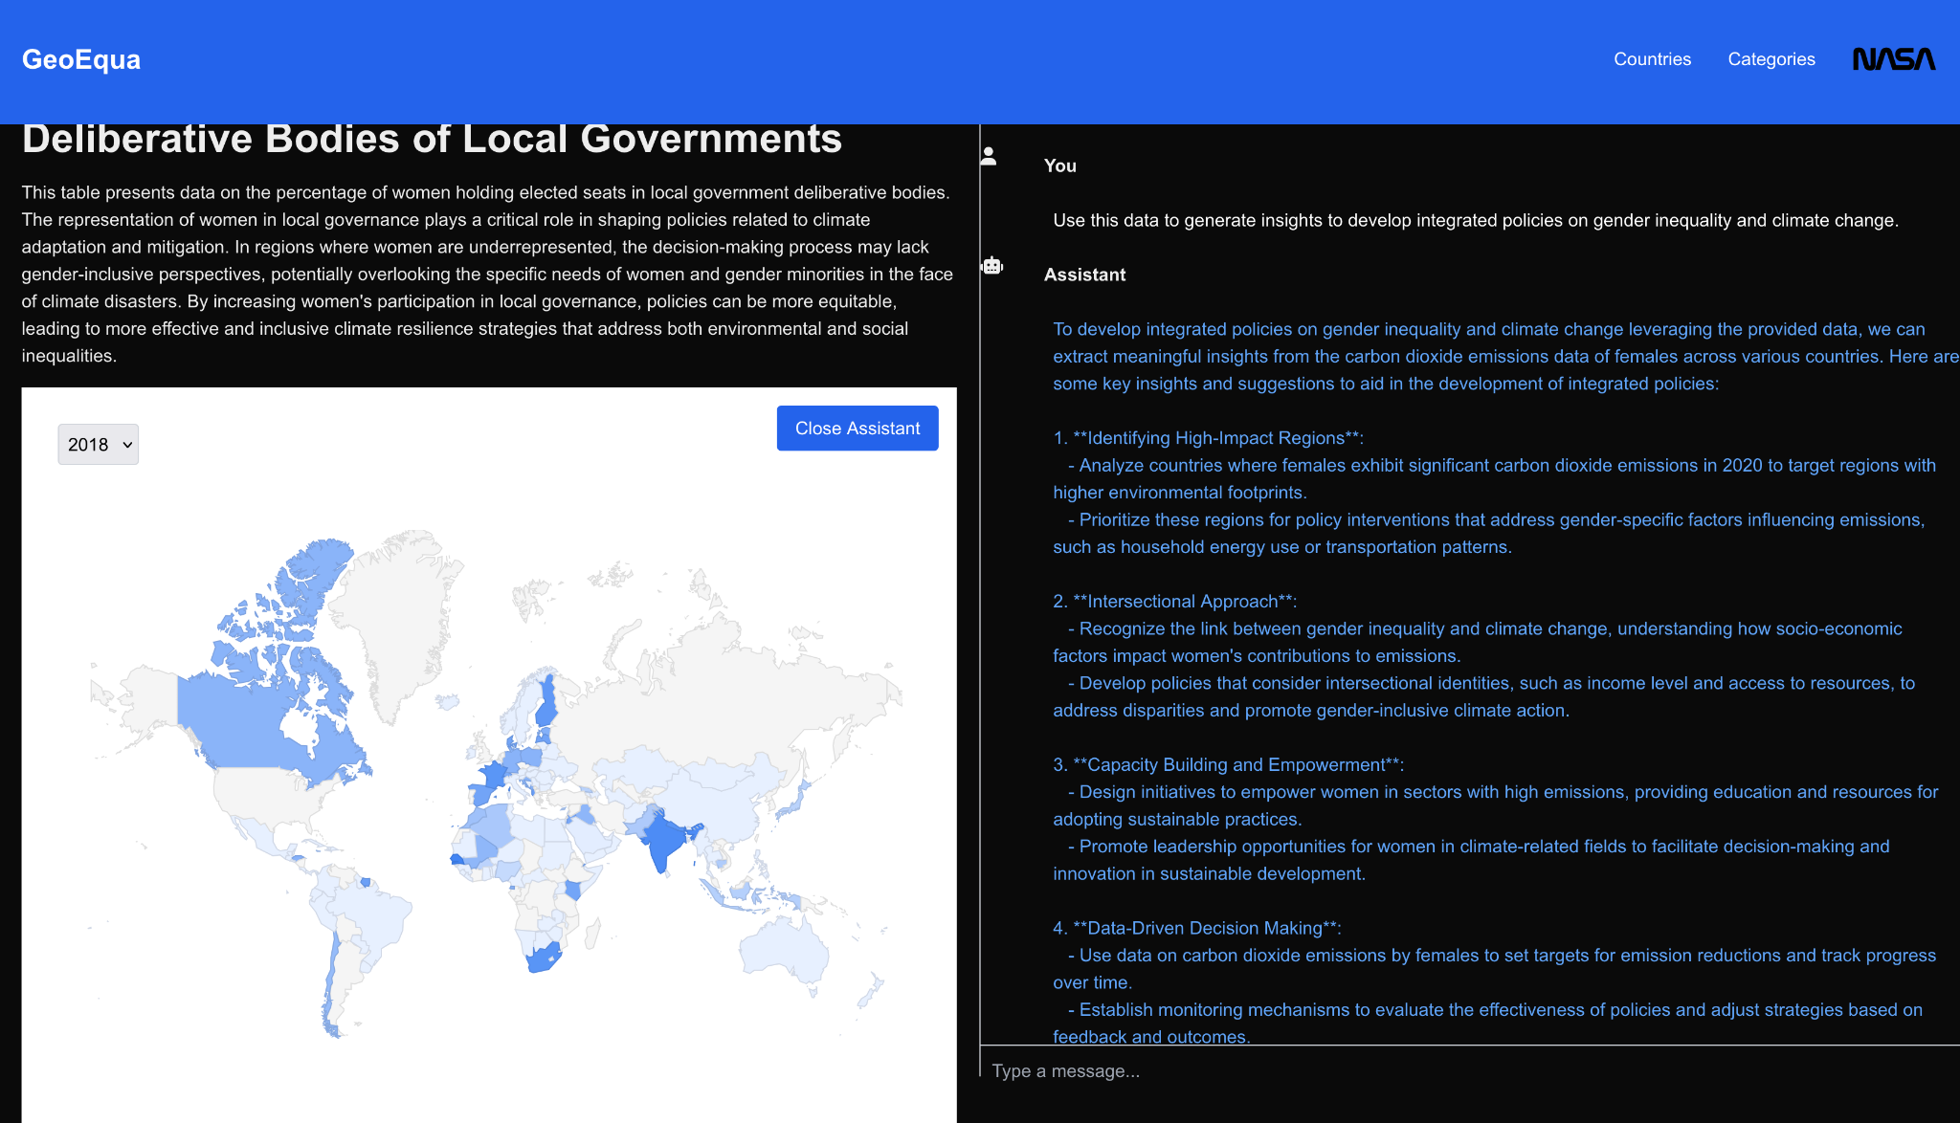
Sustainable Solution Suggestions
GeoEqua provides insights to develop integrated policies on gender inequality and climate change.

Slide 6


Conclusions and Recommendations
Sustainable climate action is not possible without gender equality. While women are disproportionately affected by the negative impacts of climate change, a 1% increase in gender equality provides a 0.8% improvement in climate adaptation. As developed countries approach their 2030 targets, the lack of transparency of data and the exclusion of women from decision-making processes in the Middle East and Africa are slowing down recovery in these regions. Climate change deepens this inequality by significantly harming women’s economic opportunities and social status. More effective climate policies can be developed in countries where equal opportunities are provided.
Governments and international organizations should increase women’s participation in decision-making processes and access to economic resources by creating policies that strengthen gender equality. Women’s leadership role should be encouraged, especially in climate adaptation projects. In addition, gender and climate change data should be published transparently in the Middle East and Africa, and more effective solutions should be developed through international cooperation in these regions. These steps will accelerate the achievement of global goals by ensuring that climate policies are more inclusive.

Slide 7

References
GeoEqua Project Demo Youtube Link: https://youtu.be/h8v0npSdwc8
GeoEqua project demo: https://geoequa.vercel.app/
Github: https://github.com/macaris64/geoequa
NASA SEDAC: https://sedac.ciesin.columbia.edu/
NASA EarthData: https://search.earthdata.nasa.gov/
UN 17 Goals: https://sdgs.un.org/goals
UN Women: https://www.unwomen.org/en
UN Data Portal: https://unstats.un.org/sdgs/dataportal/database

